Slide 1
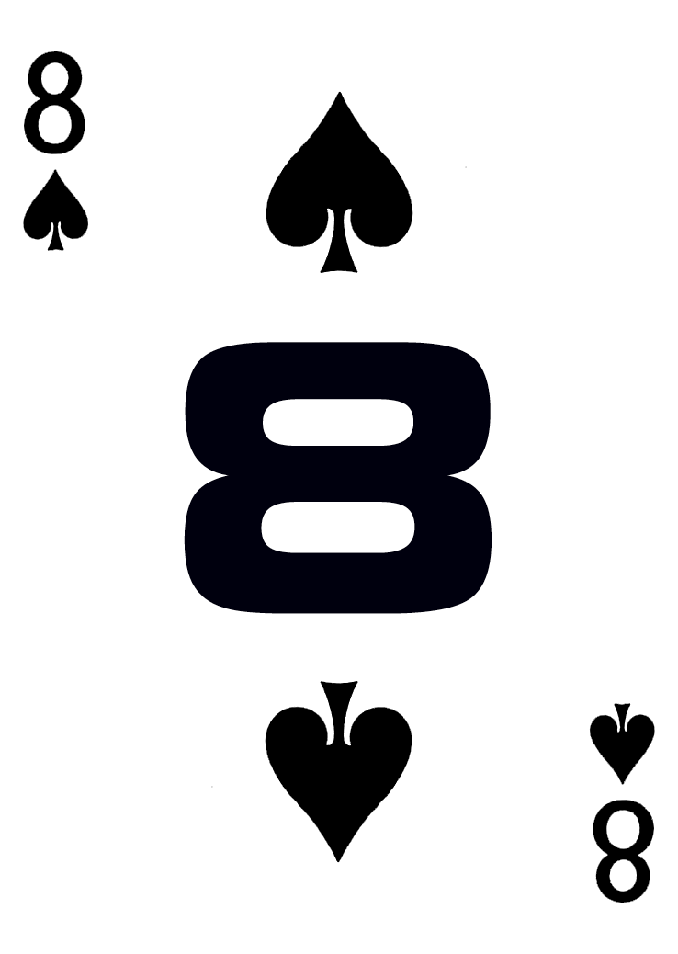
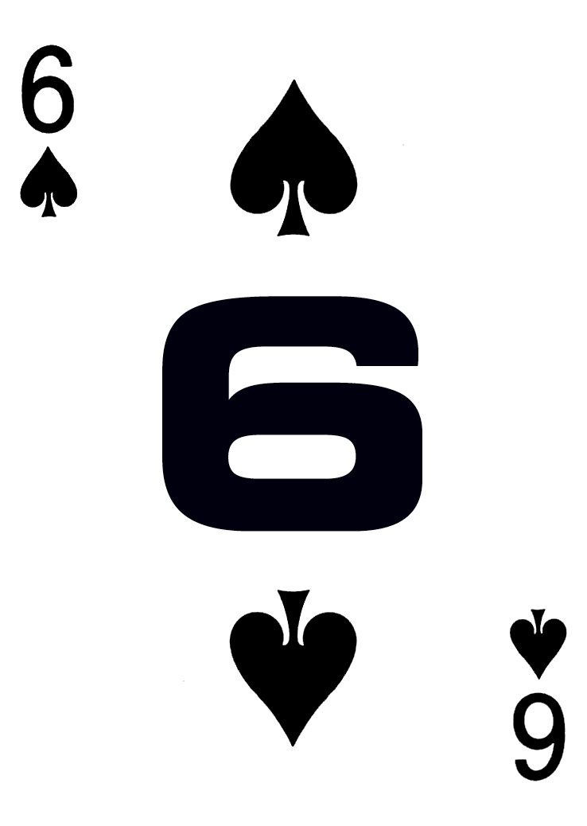
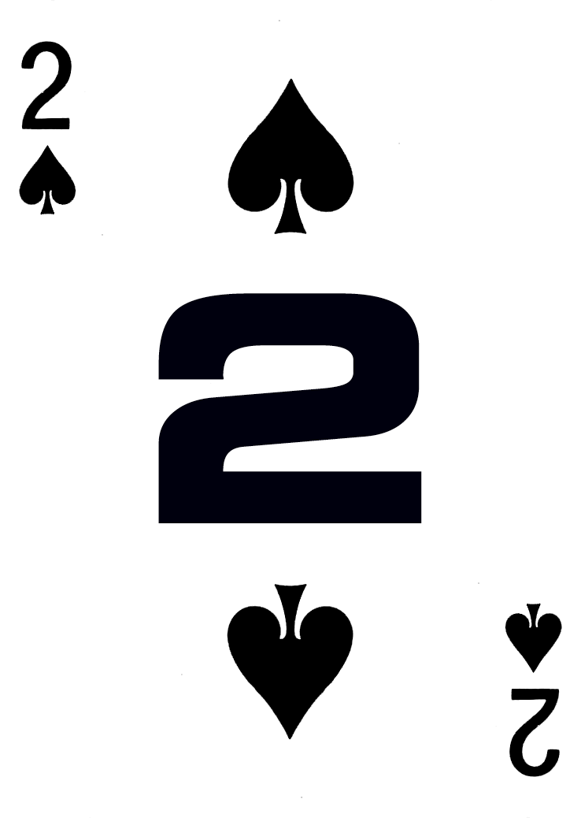
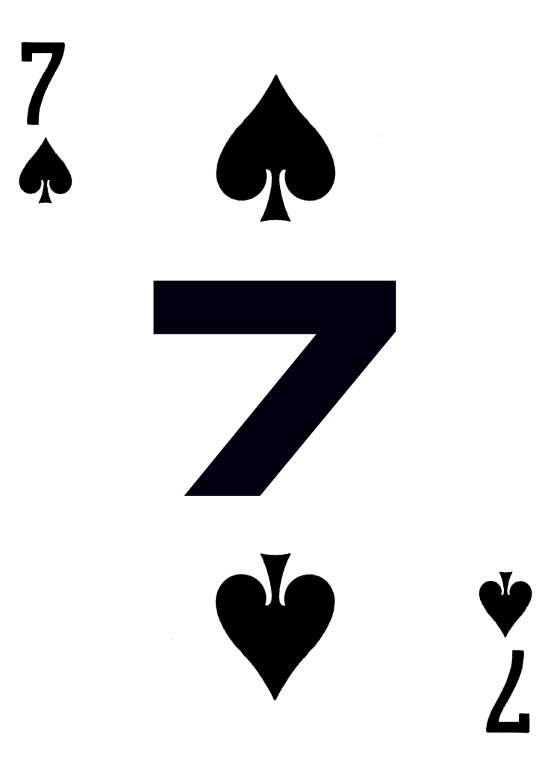
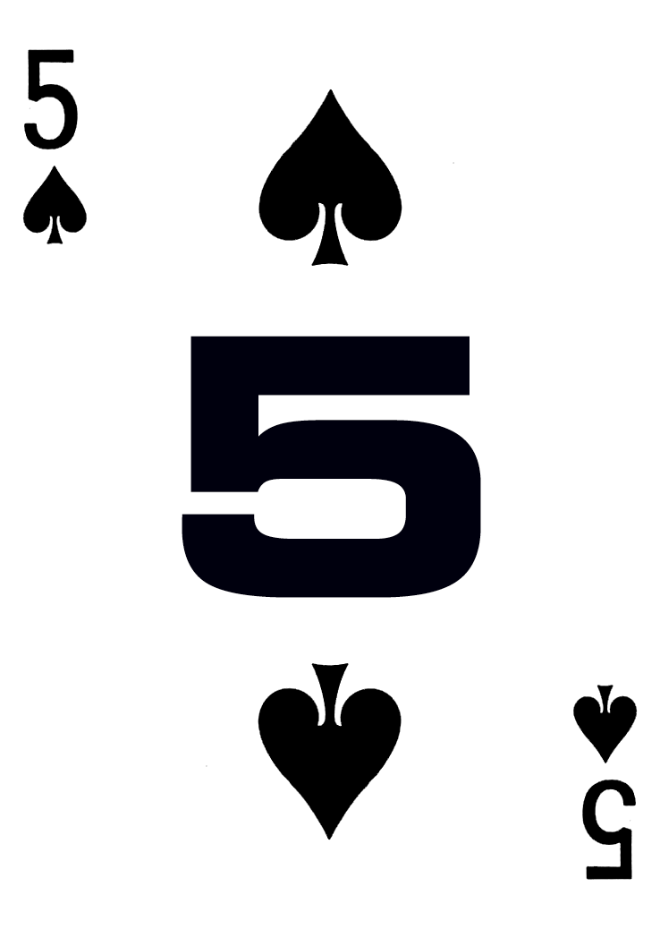
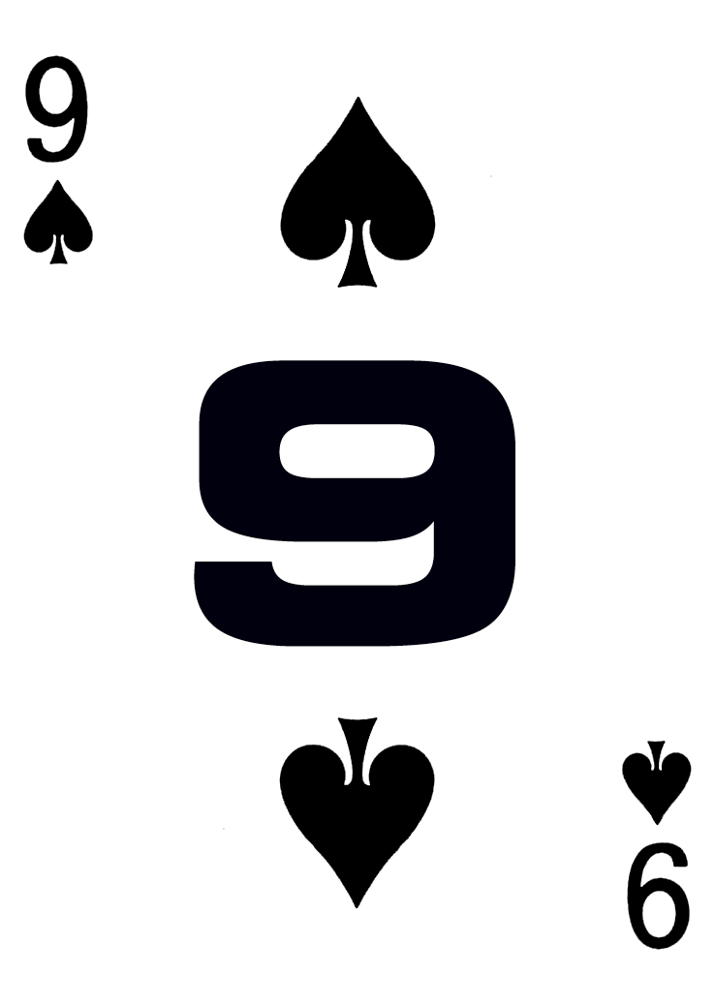
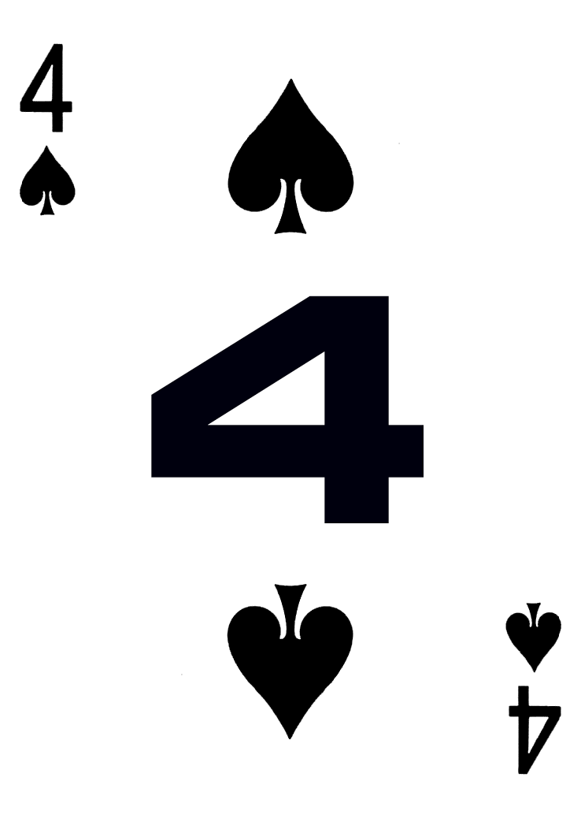
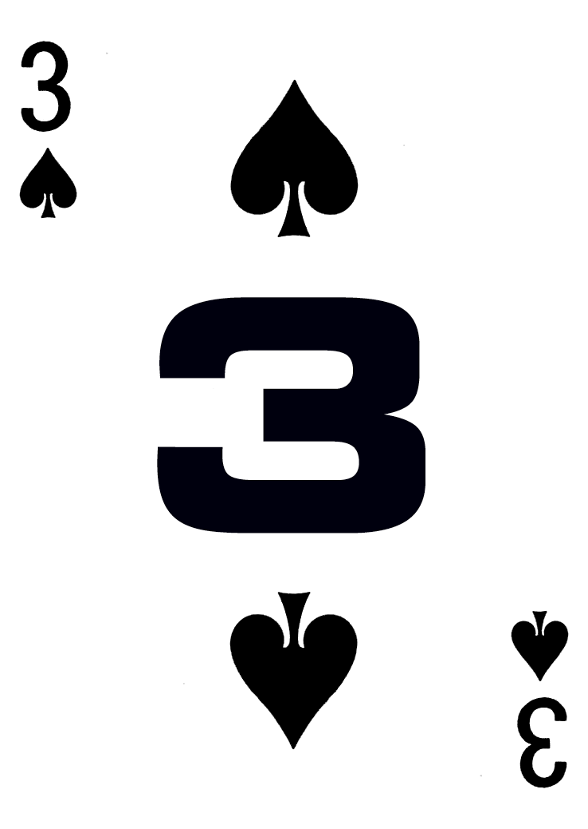
Number Slide
The goal of the game is to put the cards in order 1-11 by sliding cards into the empty spot.
The cards may only slide up/down or left/right, (not diagonally).
Only one card may be moved at a time.

Slide 2
Number Slide
The goal of the game is to put the cards in order 1-11 by sliding cards into the empty spot.
The cards may only slide up/down or left/right, (not diagonally).
Only one card may be moved at a time.

Slide 3
Number Slide
The goal of the game is to put the cards in order 1-11 by sliding cards into the empty spot.
The cards may only slide up/down or left/right, (not diagonally).
Only one card may be moved at a time.

Slide 4
Number Slide
The goal of the game is to put the cards in order 1-11 by sliding cards into the empty spot.
The cards may only slide up/down or left/right, (not diagonally).
Only one card may be moved at a time.

Slide 5
Number Slide
The goal of the game is to put the cards in order 1-11 by sliding cards into the empty spot.
The cards may only slide up/down or left/right, (not diagonally).
Only one card may be moved at a time.

Slide 6
Number Slide
The goal of the game is to put the cards in order 1-11 by sliding cards into the empty spot.
The cards may only slide up/down or left/right, (not diagonally).
Only one card may be moved at a time.

